Slide 1
CNN Training Progress
Ankush Patel – CS494 – Week 3

Slide 2
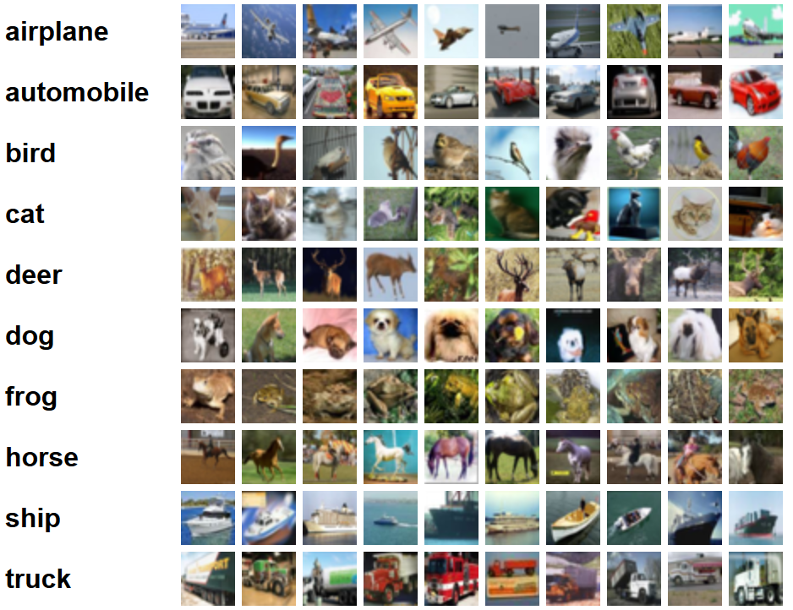
CIFAR-10
Notes:
http://www.cs.toronto.edu/~kriz/cifar.html
60000 32x32 images with 10 classes
Purpose:
A more consistent image dataset
Less time training due to smaller images

Slide 3
CIFAR-10
Notes:
http://www.cs.toronto.edu/~kriz/cifar.html
60000 32x32 images with 10 classes
Purpose:
A more consistent image dataset
Less time training due to smaller images

Slide 4
CIFAR-10
Notes:
http://www.cs.toronto.edu/~kriz/cifar.html
60000 32x32 images with 10 classes
Purpose:
A more consistent image dataset
Less time training due to smaller images

Slide 5
Training
Last week, I trained the model on four classes: birds, cats, dogs, and frogs.
This week, I picked four diverse classes: airplanes, frogs, horses, and trucks.
Training took approximately 3 hours and 30 minutes on an Intel Core i7-8550U CPU.

Slide 6
Testing
After 100 epochs, the newly combined model showed an accuracy of 0.7222.
Comparatively, the accuracy of the old combined model was 0.7968.
Although I believed the accuracy would increase in the model, it decreased.

Slide 7
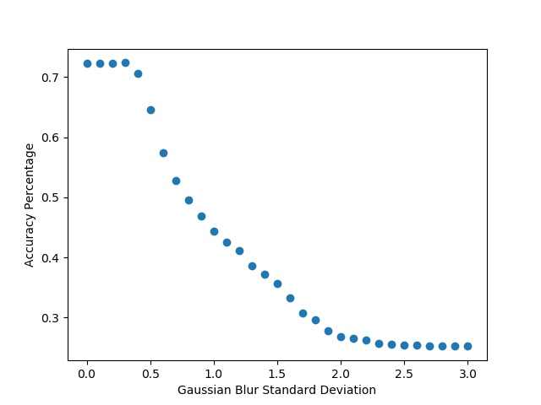
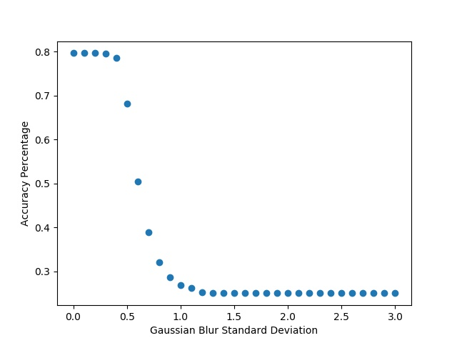
Gaussian Blur Comparison
New Combined
Old Combined

Slide 8
Gaussian Blur Bump Analysis Issues
In order to navigate the resolution space I will have to find images that are similar to the dataset that I have currently.
Furthermore, I will have to modify the current model to accept different resolutions.

Slide 9
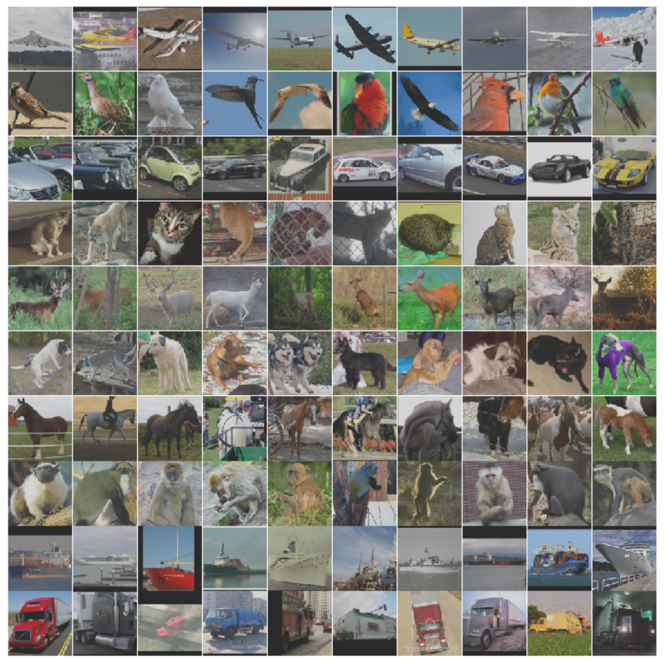
STL-10
Notes:
96x96 images that are based on the CIFAR10 dataset – possibly more noisy
Original bump was found in 64x64 images.

Slide 10
Future
Modify model to accept resolutions of different sized images.
Compute gaussian blur analysis on the newly training model from above.
Move to a new model that does object recognition.

